Slide 1
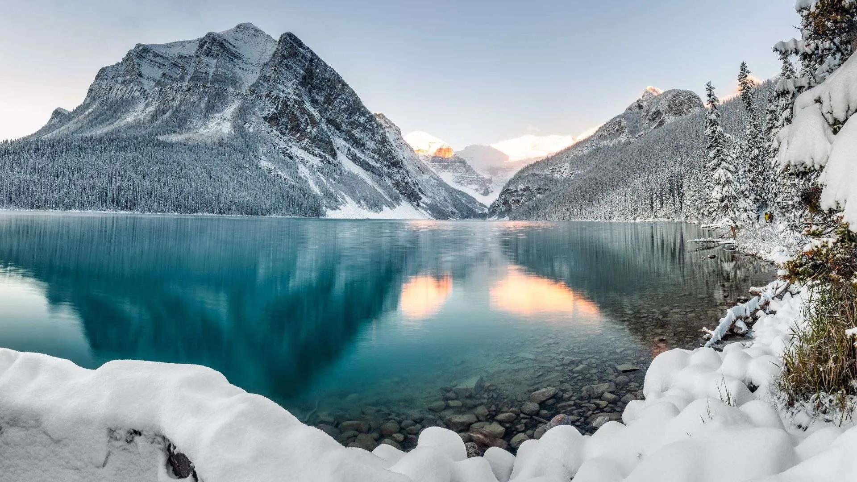
Big Mountain Resort Revenue Optimization
Sally P. Duarte
06/18/2025

Slide 2

Question:
Are there any opportunities
for maximizing profit at
Big Mountain Resort?

Slide 3
Problem Constraints:
3 options: Cut costs, increase revenue, or both?
What data do we have?
Market share data (resorts, features, etc)
Publicly available data (state size, population, etc)
What can realistically be modified?

Slide 4
Data Wrangling and Exploration
Imputed Missing Values
Target Feature: Adult Weekday Ticket Pricing
Incorporated external data (resort density)
Exploratory Data Analysis

Slide 5
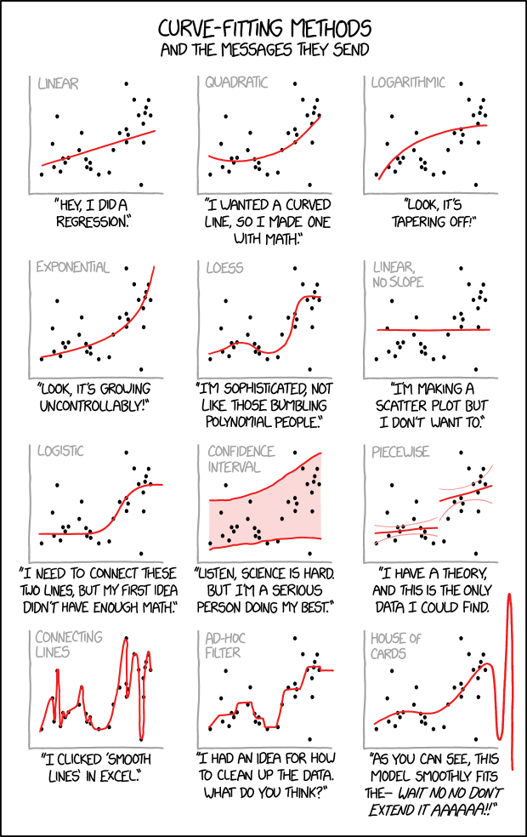
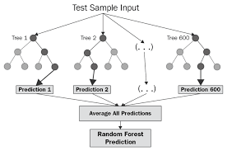
We Tested 3 Models:
Average
Linear Regression
Random Forest
Best Performance
Winning Model

Slide 6
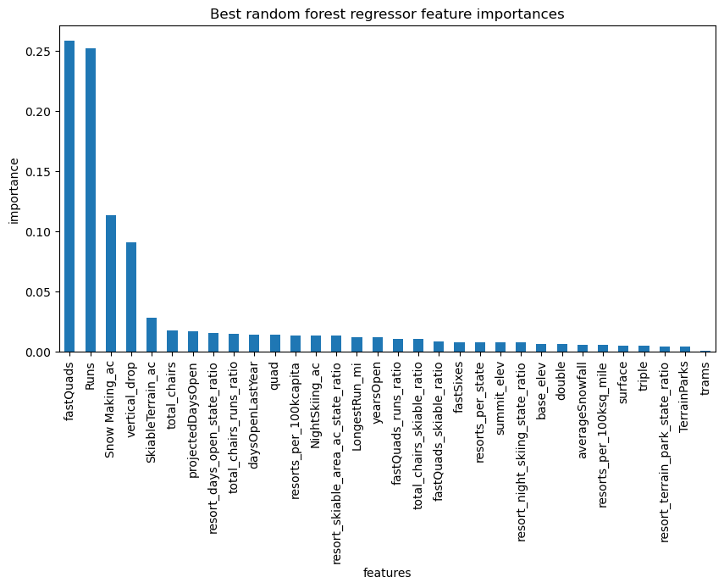
Top Four Features Influencing Ticket Price:

Slide 7
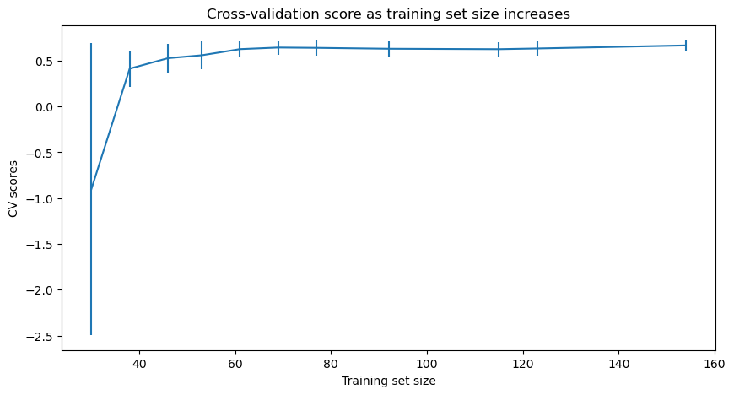
Do we need more data?
NOPE!

Slide 8
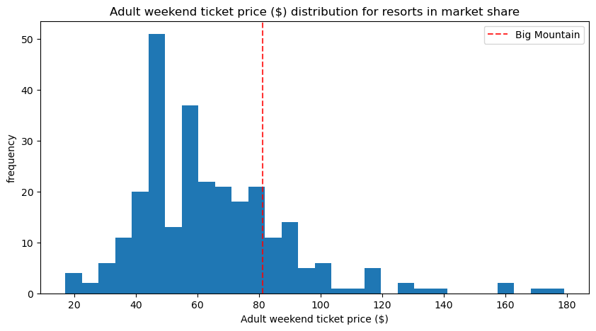
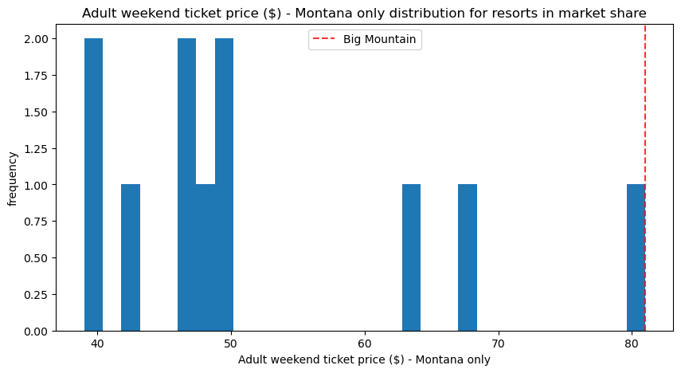
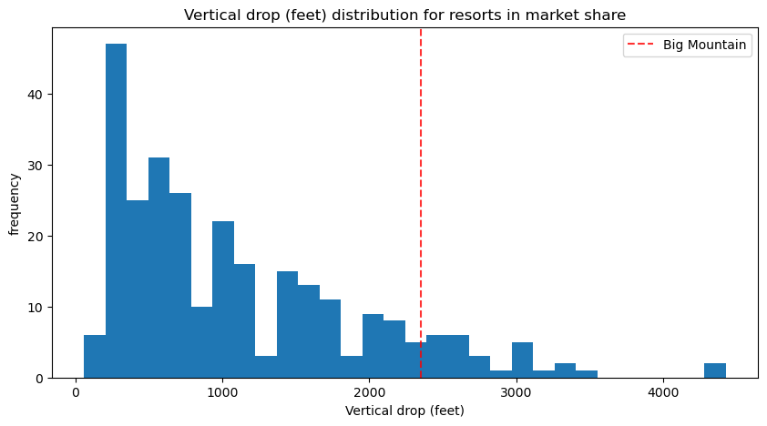
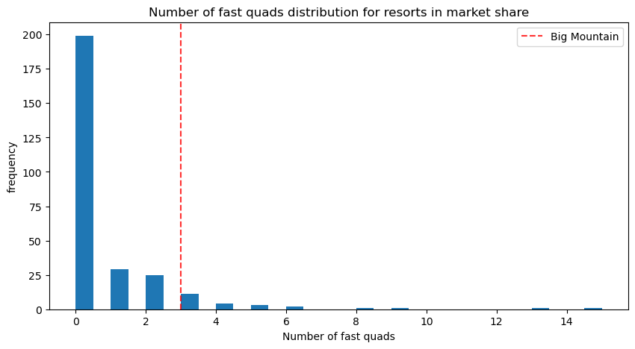
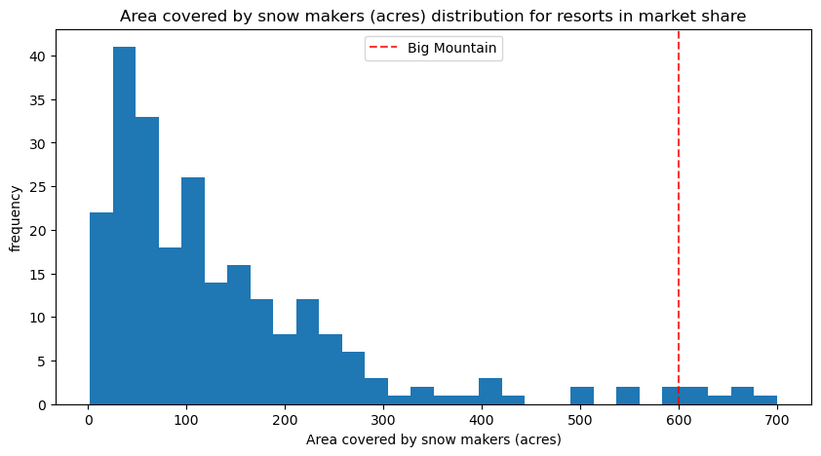
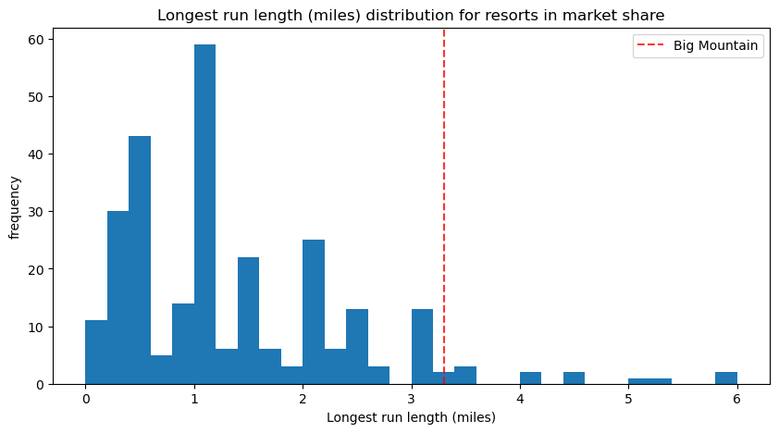
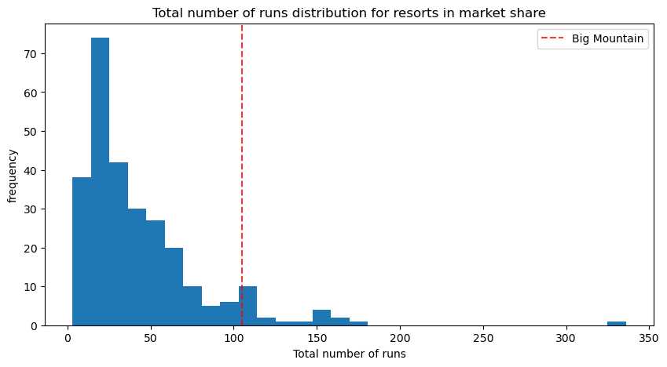
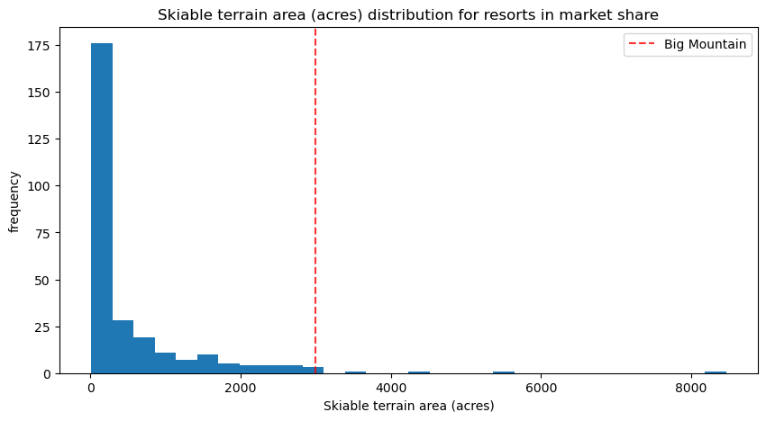
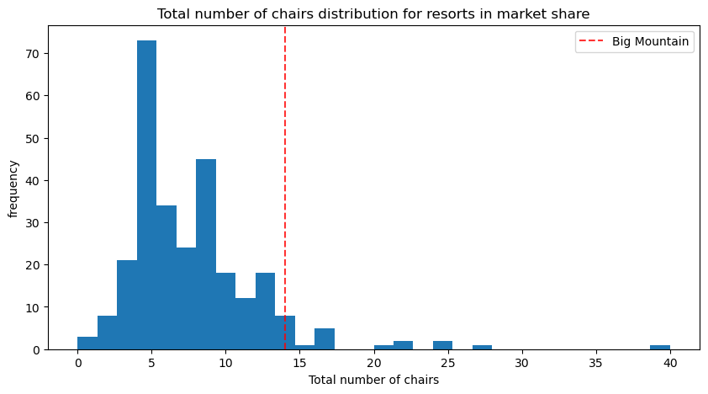
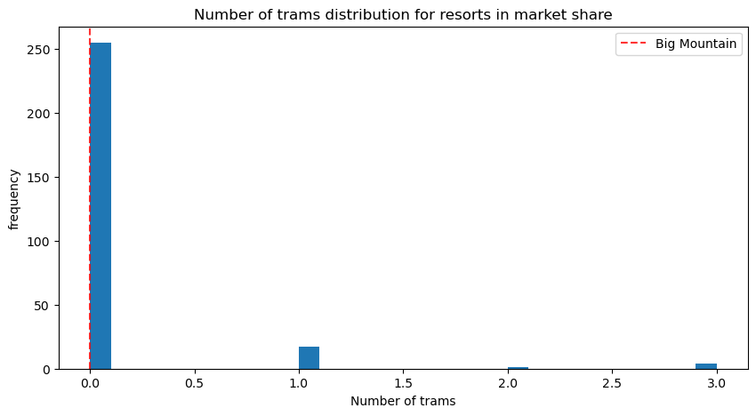
Recommended Ticket Price: $95.87
Current Price: $81

Slide 9
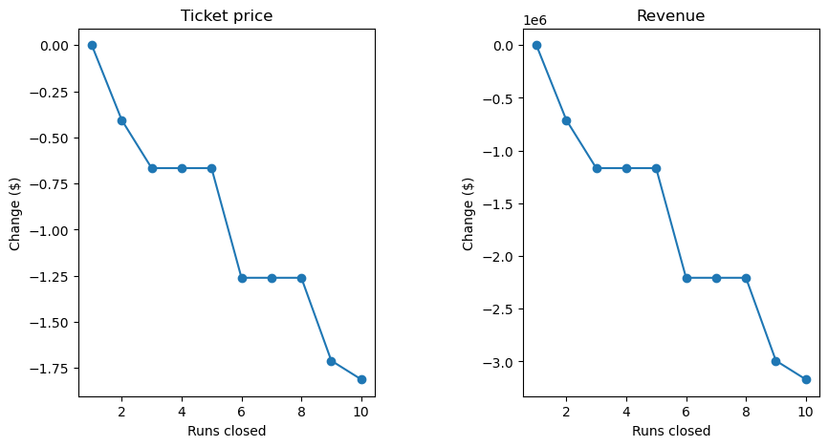
Scenario 1: Closing Runs
Results: Closing ONE run will not affect ticket prices. Closing any more than one run will necessitate a REDUCTION in ticket price and revenue.

Slide 10
Scenarios 2, 3 and 4:
2. Increase the vertical drop by adding a run to a point 150 feet lower down but require the installation of an additional chair lift to bring skiers back up, without additional snow making coverage.
Result: This scenario supports increasing ticket prices by $1.99 and revenues of $3.47million.
Same as number 2, but add 2 acres of snow making coverage.
Result: Adding the snow making coverage has no effect on ticket prices.
4. Increase the longest run by 0.2 mile to boast 3.5 miles length, requiring an additional snow making coverage of 4 acres.
Result: Increasing the longest run has no effect on ticket prices.

Slide 11
Recommendations:
Ticket prices can immediately be increased to a maximum of $95.87, based on existing facilities and comparison to the rest of the market.
Close one run in order to cut costs, without any reduction in ticket prices or revenue.
Increase the overall vertical drop by installing one chair lift, but only if the annual operating and maintenance cost for that chair lift will be less than $OpCost/$1.75mil. Ticket prices can then be raised an additional $1.99.
In the longer term, BMR should look for additional opportunities to increase the vertical drop, since that factor seems to have the greatest effect on ticket pricing.

Slide 12

Conclusion:
Both immediate/short term and
longer-term changes
can be made to
increase
BMR profit.

